Slide 1

DAVANAGERE UNIVERSITY
DEPT. OF STUDIES IN COMPUTER APPLICATIONS(MCA)
“Medicine Recommendation based on the
User Reviews”
Under the Guidance Of :
Dr.Anup Ritti B.E.,M.Tech.,Ph.D.,
Assistant Professor
Dept. Of Studies in Computer Applications
Davangere University
Submitted By:
Student Name : Karthik S.R
Reg No : P13DU23S126014
Dept. Of Studies in Computer Applications
Davangere University

Slide 2
Introduction
Background of the Project Domain
Recommendation systems are tools that suggest the best options to users. They are common in shopping and movies, and in healthcare they can help patients choose the right medicine by using reviews and ratings.
Importance of the Project
This project is important because it helps patients avoid wrong or harmful medicines. It saves time, reduces cost, and gives trusted suggestions by analyzing real patient feedback.
Scope of the Project
The system focuses on medicine recommendations but can also be used for doctors, hospitals, or treatment plans. In the future, it can be applied to other areas like education or online shopping.

Slide 3
Problem Statement
Problem to Solve
Patients find it difficult to choose the right medicine because ratings and short reviews do not show full details like side effects or effectiveness.
Existing Challenges
Star ratings are not enough.
New users or medicines have little data.
Many medicines have very few reviews.
Hard to manage large amounts of data.
Motivation for the Project
Many patients waste money or face health risks due to poor choices. At the same time, lots of reviews are available but not used properly. This project uses AI and deep learning to give smarter, reliable, and personalized medicine recommendations

Slide 4
Objectives
Main Objectives
To build a medicine recommendation system.
To use reviews, ratings, and AI for better suggestions.
To give patients accurate and useful medicine choices.
Sub Goals
Collect reviews from users and websites.
Clean the data (remove unwanted words/symbols).
Find useful features (effectiveness, side effects, cost).
Check review sentiments (positive, negative, neutral).
Rank and recommend the best medicines.
Aim of the Project
To help patients select the right medicine easily and safely using personalized AI-based recommendations.

Slide 5
Literature Review
References | Author | Method | What It Does | Result / Accuracy
[1] | LeCun, Bengio & Hinton (2015) | Deep Neural Networks | Learns patterns from raw data | Helps AI get better at many tasks
[2] | Mikolov et al. (2013) | Word2Vec | Turns words into numbers to show meaning | Understands text better than old methods
[3] | Devlin et al. (2019) | BERT | Understands sentence context | Best accuracy in NLP tasks
[4] | Hutto & Gilbert (2014) | VADER | Works well with short text | Good for reviews and comments
[5] | Koren, Bell & Volinsky (2009) | Matrix Factorization | Finds hidden patterns for recommendations | Better personalized suggestions

Slide 6
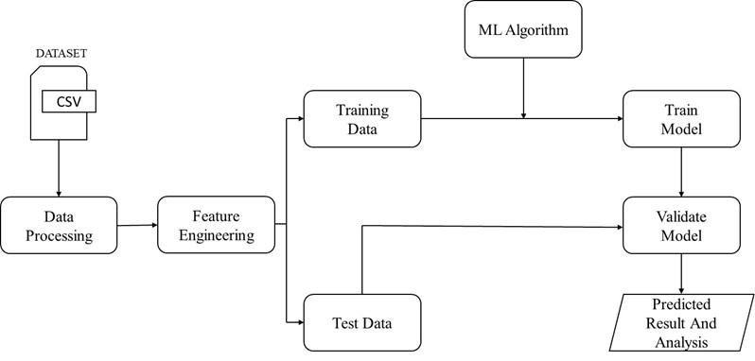
SYSTEM ARCHITECTURE

Slide 7
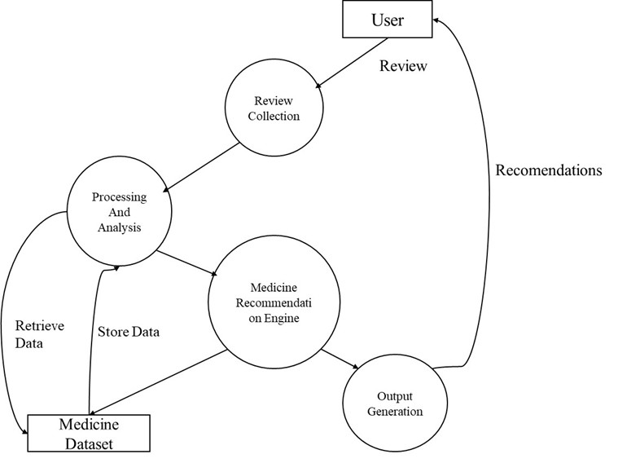
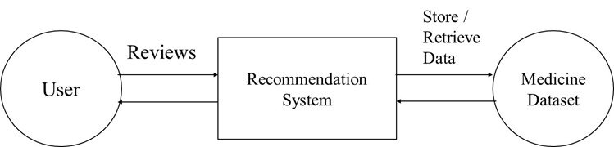
DATA FLOW DIAGRAM
Level 0 DFD diagram
Level 1 DFD diagram

Slide 8
TOOLS AND TECHNOLOGIES
SOFTWARE REQUIREMENTS
Operating System: Debian Linux / Windows
IDE/Editor: Atom
Programming Language: Python 3.8
Frameworks & Tools: Django, HTML, CSS, Bootstrap, JavaScript
Utilities: Browser, Terminal
HARDWARE REQUIREMENTS
RAM: 2 GB (minimum)
Storage: 3 GB Disk Space
Input Devices: Touchpad / Mouse

Slide 9
Methodology/implementation details
Methodology — Step by Step
Get Data – Collect medicine names, star ratings, and text reviews from CSV or database.
Clean Text – Remove HTML, punctuation, stopwords; convert to lowercase and lemmatize words.
Convert Text to Numbers – Use TF–IDF or word embeddings (Word2Vec).
Train Model – Use LSTM or simple classifiers (Logistic Regression / SVM) to map reviews to sentiment or condition.
Sentiment Scoring – Get positive, neutral, or negative sentiment using VADER or model output.
Make Feature Matrix (FEM) – Each medicine gets features like sentiment score, avg rating, usefulness, key tokens.
Rank & Recommend – Combine ratings, sentiment, and collaborative signals to list top medicines.
Show Results – Display ranked list with explanations and simple charts on the web page.

Slide 10
Algorithms
Algorithms
TF–IDF – Converts review words into numbers to show important words.
LSTM / Text Models – It is used to understand the sentence/review
Logistic Regression– Simple models for classifying conditions in small datasets.
VADER – Quick rule-based sentiment analysis for short reviews.
Rule-based Ranking – Example: pick medicines with rating ≥ 9 and useful count ≥ 100, then sort.

Slide 11
Key Modules
Key Modules
Authentication – Signup/login for verified users.
Review Collection – Collect reviews from users or trusted sites.
Data Cleaning – Remove noise and prepare text for analysis.
Sentiment Analysis – Assign sentiment label or score to each review.
Feature Extraction – Build FEM (medicine × features).
Recommendation Engine – Combine ratings, sentiment, and features to rank medicines.
Visualization – Show ranked lists and charts for easy understanding.

Slide 12
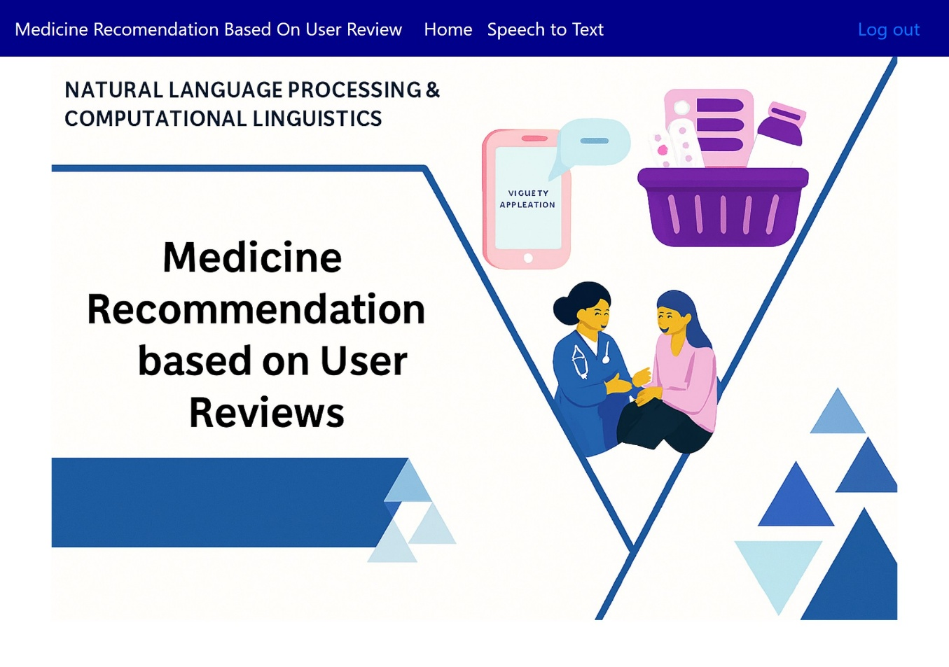
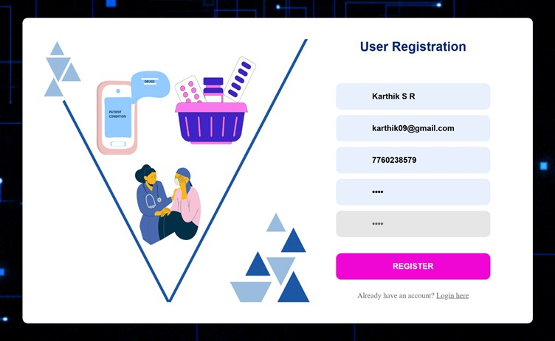
RESULTS/OUTPUT
Home Page
Register Page

Slide 13
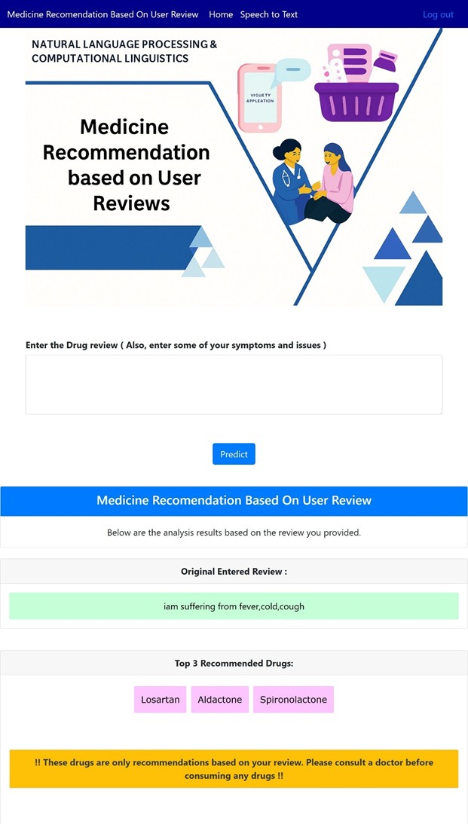
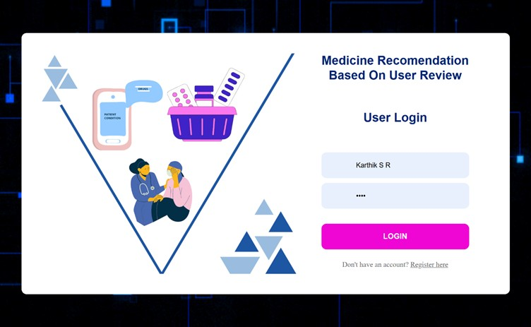
Login Page
Predict Page

Slide 14
Challenges Faced
1. Technical Challenges
Integrating different modules (login, data cleaning, sentiment analysis, recommendation).
Choosing the right algorithms for text analysis and recommendations.
Handling errors while connecting frontend (HTML/CSS/JS) with backend (Flask/Django).
2. Data-Related Issues
Raw reviews were noisy (spelling mistakes, special characters, stopwords).
Small dataset → less accuracy.
Cold-start problem (new users/medicines had no reviews).
3. Time Constraints
Limited time to design, implement, and test full system.
Needed to learn multiple tools (Python, ML, NLP, Flask/Django).

Slide 15
Conclusion
Summary of Achievements:
The project successfully built a medicine recommendation system that combines user reviews, ratings, and sentiment analysis. It achieves better accuracy than using star ratings alone. The web application is modular and user-friendly, making it easy to use and update.
Project Impact:
This system helps patients choose safe and effective medicines, saving time and money, and increasing trust in digital healthcare platforms. It also shows how AI and NLP can solve real-world healthcare problems.
Key Takeaways:
User reviews provide more information than just star ratings. Combining machine learning with sentiment analysis improves recommendations. The modular design makes the system easy to update and expand. This approach can be extended to hospitals, doctors, or even other areas like movies, books, or courses.

Slide 16
Future Work / Scope for Improvement
1. Future Enhancements
Add multilingual support so reviews in different languages can be analyzed.
Collect larger datasets from hospitals, pharmacies, and medical forums.
Build a mobile app for easier access.
Use cloud deployment for scalability and faster performance.
Integrate with hospital or pharmacy databases for verified recommendations.
2. Current Limitations
Works best with English reviews only (other languages not fully supported).
Accuracy depends on the size and quality of the dataset.
Performance may slow down for very large datasets.
Limited ability to capture detailed medical context (like dosage, side effects, patient history).

Slide 17
References
Y. LeCun, Y. Bengio, and G. Hinton, “Deep learning,” 2015.
T. Mikolov et al., “Efficient Estimation of Word Representations in Vector Space,” 2013.
J. Pennington et al., “GloVe: Global Vectors for Word Representation,” 2014.
P. Bojanowski et al., “Enriching Word Vectors with Subword Information (fastText),” 2017.
J. Devlin et al., “BERT: Pre-training of Deep Bidirectional Transformers for Language Understanding,” 2019.

Slide 18
THANK YOU

